Slide 1


Software Engineering Course Scrum
Prepared By: Safiullah Mahmoodi

Slide 2
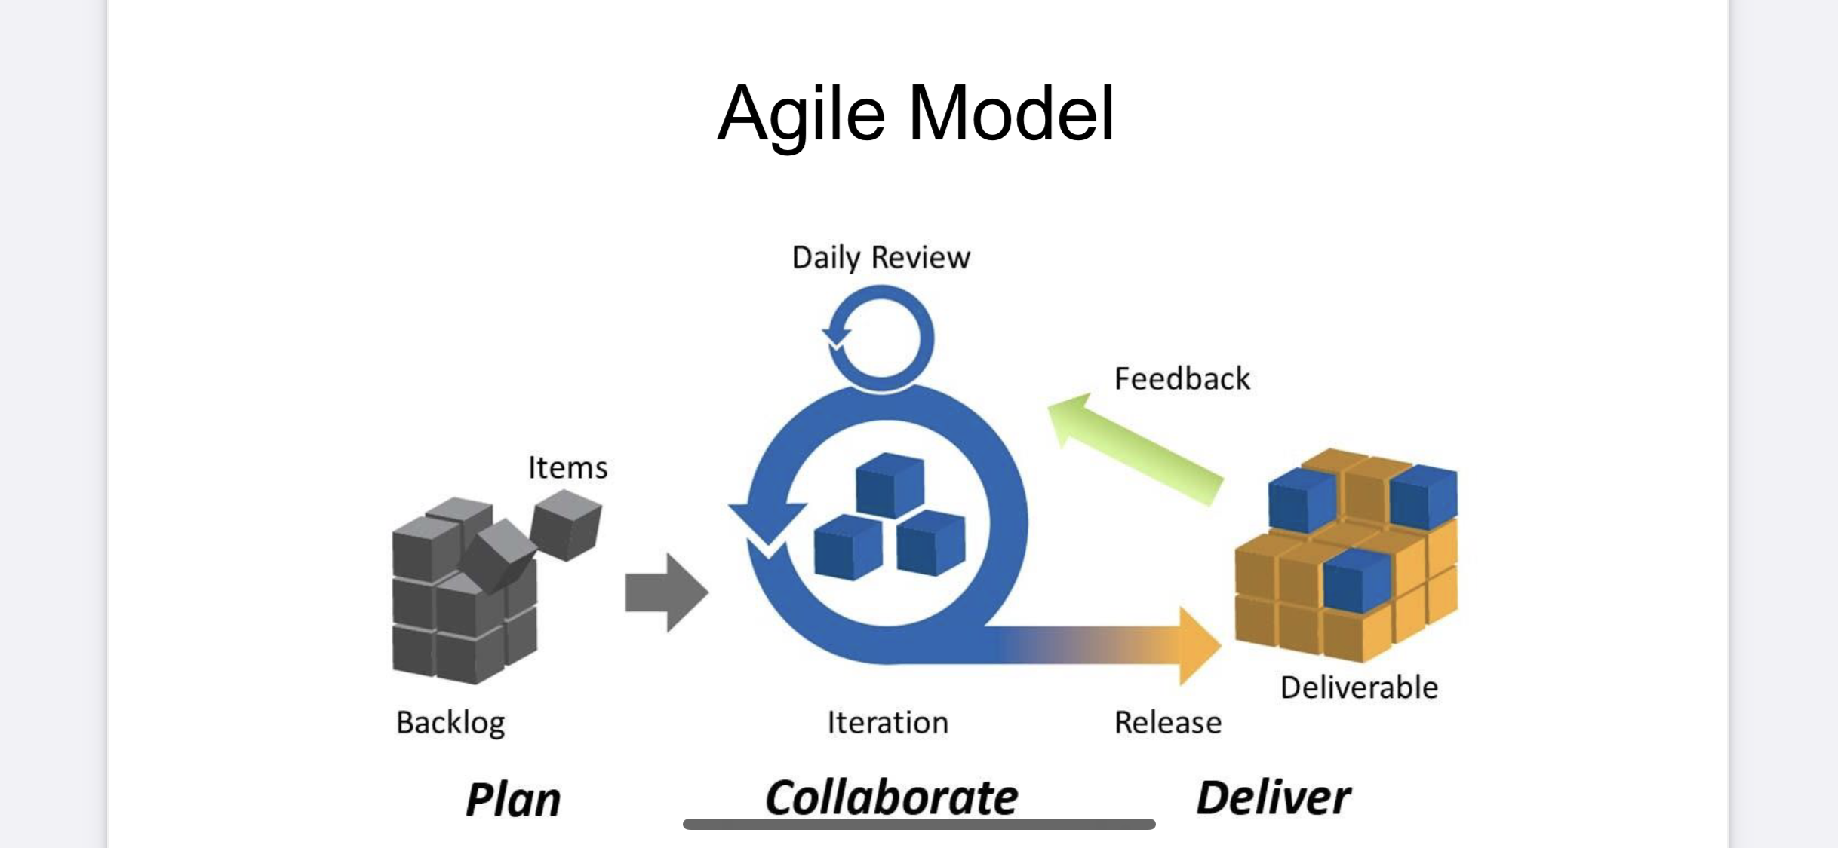
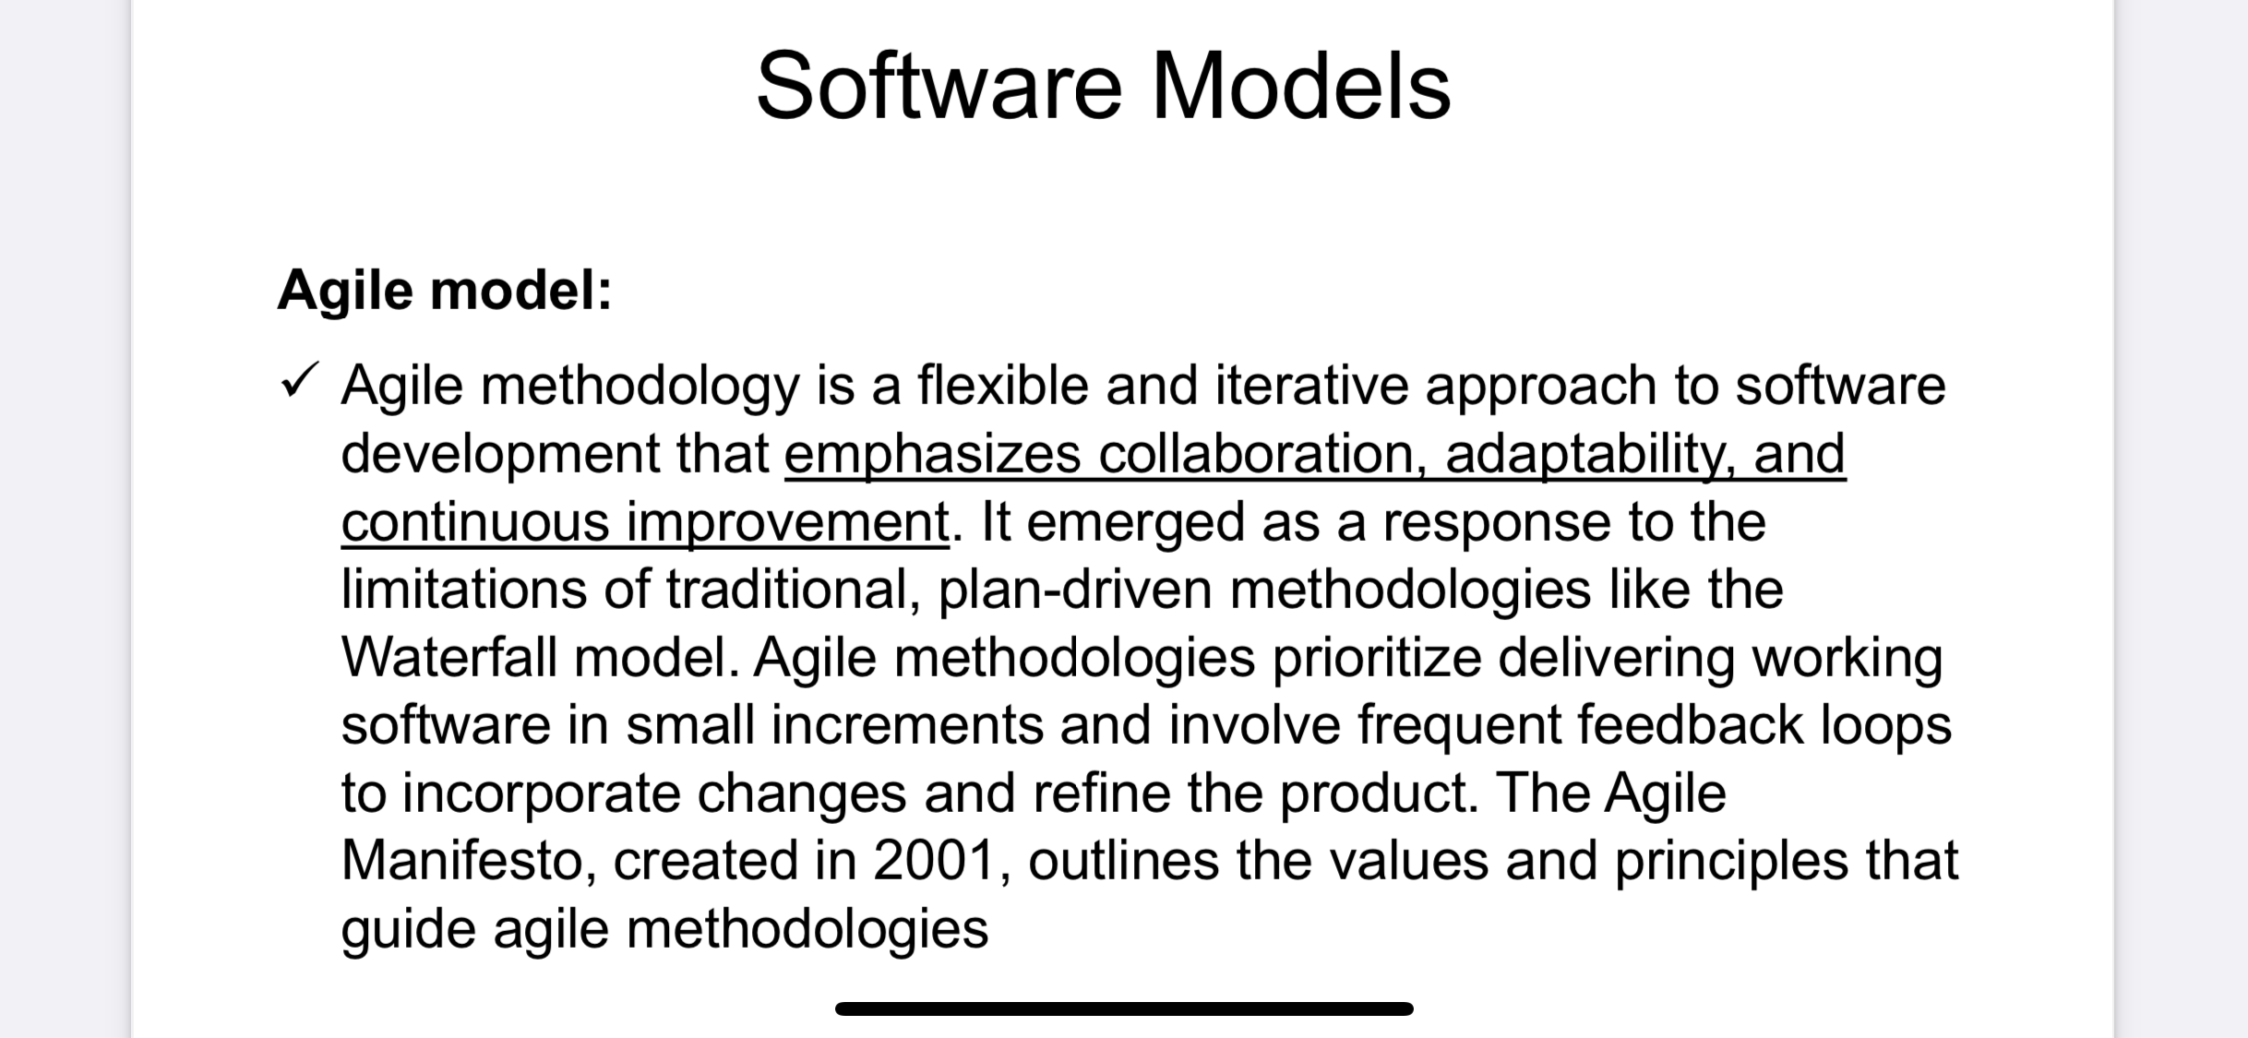

Agile Model

Slide 3

Scrum
Scrum is an Agile framework used for managing and completing complex projects, particularly in software development. It emphasizes iterative progress, collaboration, and flexibility, allowing teams to respond quickly to change and deliver high-quality products.

Slide 4
History Of Scrum
Origin Of Scrum
1990
First Conference and Expansion
1995
Publication of Agile Methodology
2001
Scrum was introduced as a project management framework in 1993 by Jeff Sutherland and Ken Schwaber. They were seeking ways to improve software development process.
The term ”scrum” is derived from the world of rugby, where teams collectively work together to achieve a common goal.
In 1995, Ken Schwaber and Jeff Sutherland held the first scrum conference in San Diego. This conference helped spread the concept of Scrum and attracted the attention of many developers and project managers.
In 2001, a group of 17 pioneers in software development published the Agile Manifesto. This Methodology included principles and values, with Scrum being one of the most significant.
This statement significantly impacted the adoption and spread of Agile methods, including Scurm.

Slide 5
History Of Scrum
Development and Evolution
2000-2010
Standardization and Certifications
2010
Global Expansion
2010
In 2000s, Scrum became one of the most popular project management methodologies. Both large and small companies gradually began implementing it.
In 2010, Scrum Alliance and Scrum.org were established as the main organizations for providing training and issuing certifications related to Scrum.
Today Scrum is used not only in the software industry but also in various fields such as project management, marketing, manufacturing, and even educations.

Slide 6
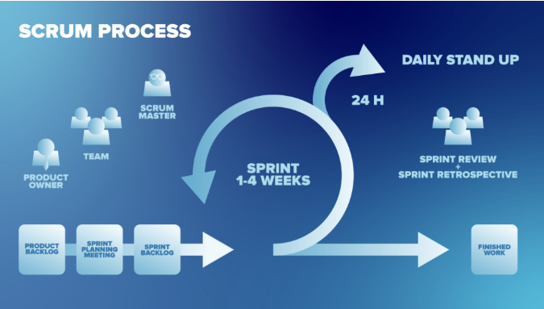
How It Works

Slide 7
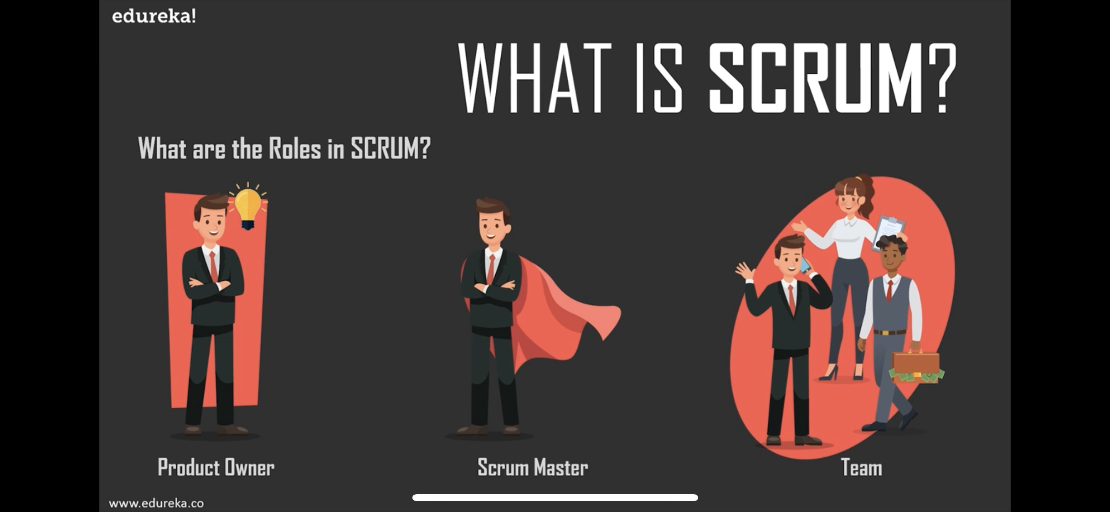
Roles on Scrum
Product Owner
Scrum Master
Team
Represents the stakeholders and is responsible for defining the product backlog, prioritizing features, and ensuring that the team delivers value to the business.
Acts As a facilitators for the Scrum team, helping to remove to obstacles, ensuring adherence to Scrum practices, and coaching the team on Agile principles.
A cross-functional group of professionals who work together to deliver potentially shippable increments of the product at the end of each sprint

Slide 8
Events on Scrum
Sprint: A time-boxed iteration, typically lasting 1 to 4 weeks, during which the team works to complete a set of backlog items.
Sprint Planning: A meeting at the beginning of each sprint where the team discusses what work will be done and how it will be achieved.
Daily Scurm(Stand up): A short daily meeting (usually 15 minutes) where team member discuss progress, plans for the day, and any obstacles they are facing.
Sprint Review: A meeting held at the end of a sprint where the team demonstrates what they have built and gathers feedback from stakeholders.
Sprint Retrospective: A meeting after the Sprint Review where the team reflects on the sprint and identifies areas for improvement in processes or team work.

Slide 9





Thank You
Safiullah Mahmoodi
+93 775503386
safiullahmahmoodi480@gmail.com
Safiullah Mahmoodi

